Slide 1

Data Analyst Internship Task – The Skill Guru Foundation
Analysis & Recommendations
by SAFARKHAN S

Slide 2
01
Metric Identification
02
Analysis & Insight
CONTENT
03
Recommendations
04
Conclusion

Slide 3
Metric Identification
TITLE 01

Slide 4

01.Course Enrollment Rate
Tracks how many users are enrolling in high-demand courses, ensuring that these courses are visible and easily accessible.

Slide 5
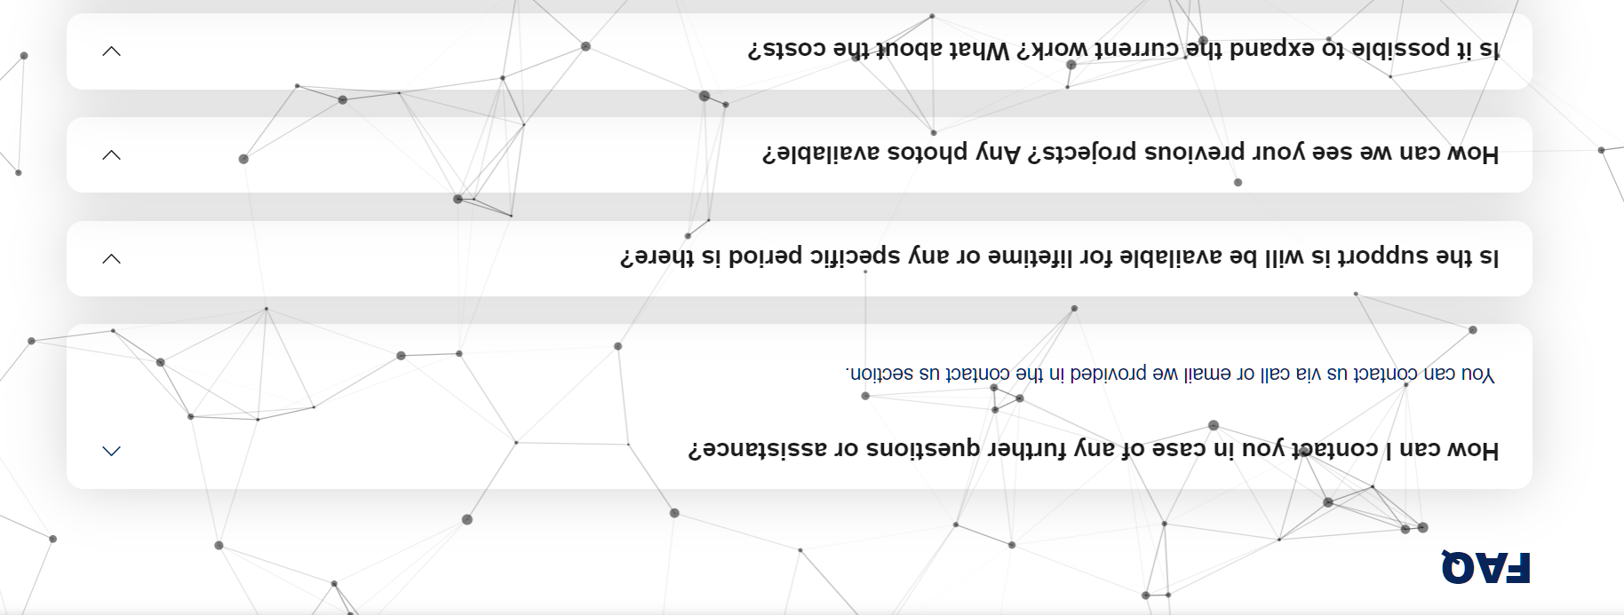
02.User Retention Rate
Measures the frequency with which users engage with support tools, like a FAQ to enhance user experience and retention.

Slide 6
Analysis & Insight
TITLE 02

Slide 7



Analysis & Insight
The site appears to have a diverse range of courses which is beneficial. However, key courses such as Electrical And Electric Vehicle Technology and Digital Marketing and Business Automation are not prominently displayed on the landing page, which could be affecting enrollment rates for these courses. Additionally, the current design with moving background images can be distracting and may deter users from exploring further.

Slide 8


Conclusion
To enhance user engagement and improve site performance, I recommend a redesign of the website to focus more on highlighting key courses prominently on the landing page. Removing distracting background images and adding a chatbot for real-time assistance can also improve user experience. Furthermore, showcasing achievements and testimonials from students, as well as statistics on enrolled and placed students, can build trust and demonstrate the success of the courses offered. This approach can potentially increase both course enrollment and user retention rates.

Slide 9
THANKS
SAFARKHAN S

